Slide 1
Top selling products

Slide 2
Key Takeaways
Yearly Product Sales Overview: I want an overview of sales for all products launched in the past year to grasp their overall performance.
Highlight Top Performers: I want a list of products that consistently top the sales charts to identify and celebrate our stars.
Visual Representation of Product Sales: I want a visual breakdown (like a bar chart or pie chart) to clearly see the hierarchy of product sales.
Product Sales Trends Over Time: I want to observe the sales trends of newly launched products over time to determine if there's sustained interest or a decline.
Correlation with Marketing Efforts: I want to know if any marketing campaigns or promotions correlate with spikes in sales for our top products to evaluate the effectiveness of our marketing pushes.

Slide 3
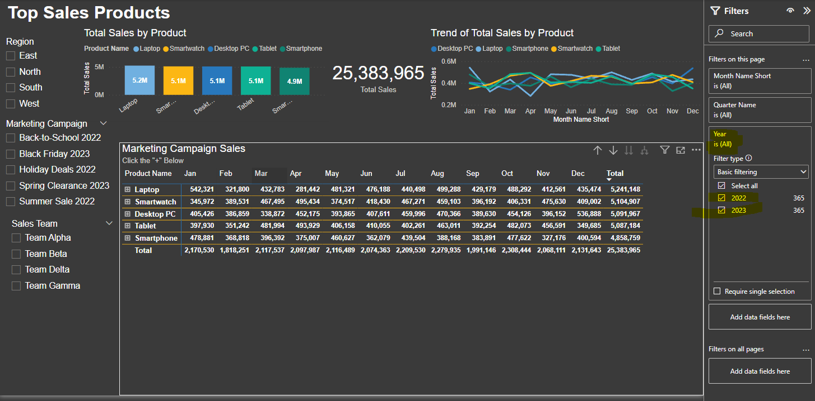
Yearly Product Sales Overview
Filter provided to see sales for 2022/2023.

Slide 4
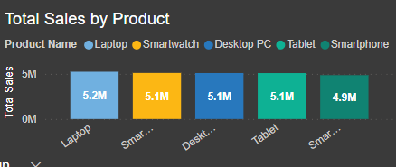
Highlight Top Performers / Visual Representation of Product Sales
Labeled Bar Chart in descending order to show what product sold the most.

Slide 5
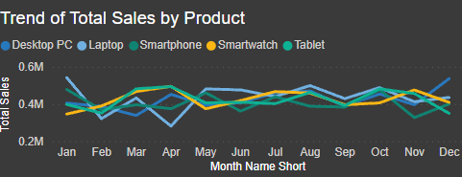
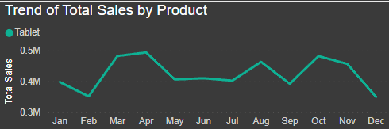
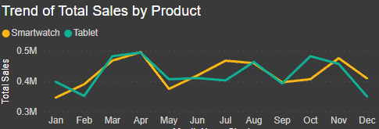
Product Sales Trends Over Time
Trend Chart that can be filtered by product to show trend of sales over time.

Slide 6
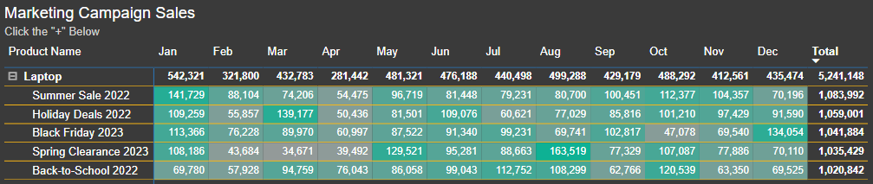
Correlation with Marketing Efforts
Table with high campaign sales highlighted bright green and low campaign sales highlighted light gray.

Slide 7
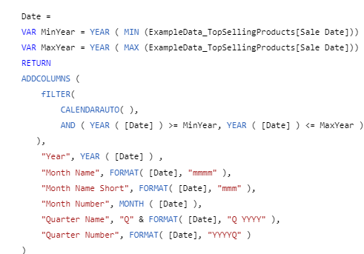
Creation of the campaign table using dax
Creates a Table that generates a calendar to help sort dates in the original data spreadsheet by year, month, and quarter.

